Slide 1

Canada Revenue Agency
Project Cost Difference & Delivery Success Forecast
Algonquin College
BISI 2023 Fall
Ziang Cui Xiaomeng Xu Li Zhuang Bo Yang Ang Li

Slide 2
Project Overview
Background
Project Success: Accurate budget forecasting and cost control
Objective
Estimate and Actual Cost Difference Prediction
Delivery Success Prediction
Data-Driven Insights
Tools
Power BI
Machine Learning

Slide 3
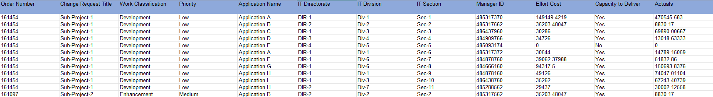
Data Overview
Data Source
OPS-PM Baseline Cost (Synthetic).xlsx
Data Scale
relatively small
64 rows, 12 column
Data Processing
The data is almost clean

Slide 4

Data Analysis from Power BI
Key Metrics and Trends
Chart Report: 7 Pages, 27 charts.
Capacity of deliver: Priority, Work classification and Department(DIR-DIV-SEC)
Cost difference: Manager and Application Name

Slide 5
 | Priority | Work Classification | Department
Major influencer | ✅ | ❌ | ✅
Impact multiplier | 6.19 | - | 41.25
※ Capacity of Deliver could be Predict well
 | Manager | Application Name
Major influencer | ❌ | ❌
Impact multiplier | - | -
※ Cost Difference could NOT be Predict well

Slide 6
Dive into the Powear BI

Slide 7

Machine Learning Steps
Data Observation Input/Output Configuration Model Tuning Conclusion
Model Selection Model Build Up Model Evaluation
0% 10% 20% 30% 60% 80% 90% 100%
Food Material Observation Choose Food Material Seasoning Conclusion
Recipe Selection Let’s cook! Tasting

Slide 8
Machine Learning - Model Selection（Recipe Selection）
20%
Model Selection
Problem Type
Data Features
Models
Capacity to Deliver
Classification Forecast
Data Size
Data Dimensions
Data Value
Logistic Regression
Decision Tree
Random Forest
Cost Difference Ratio
Regression
Forecast
Linear Regression
Decision Tree
Random Forest

Slide 9
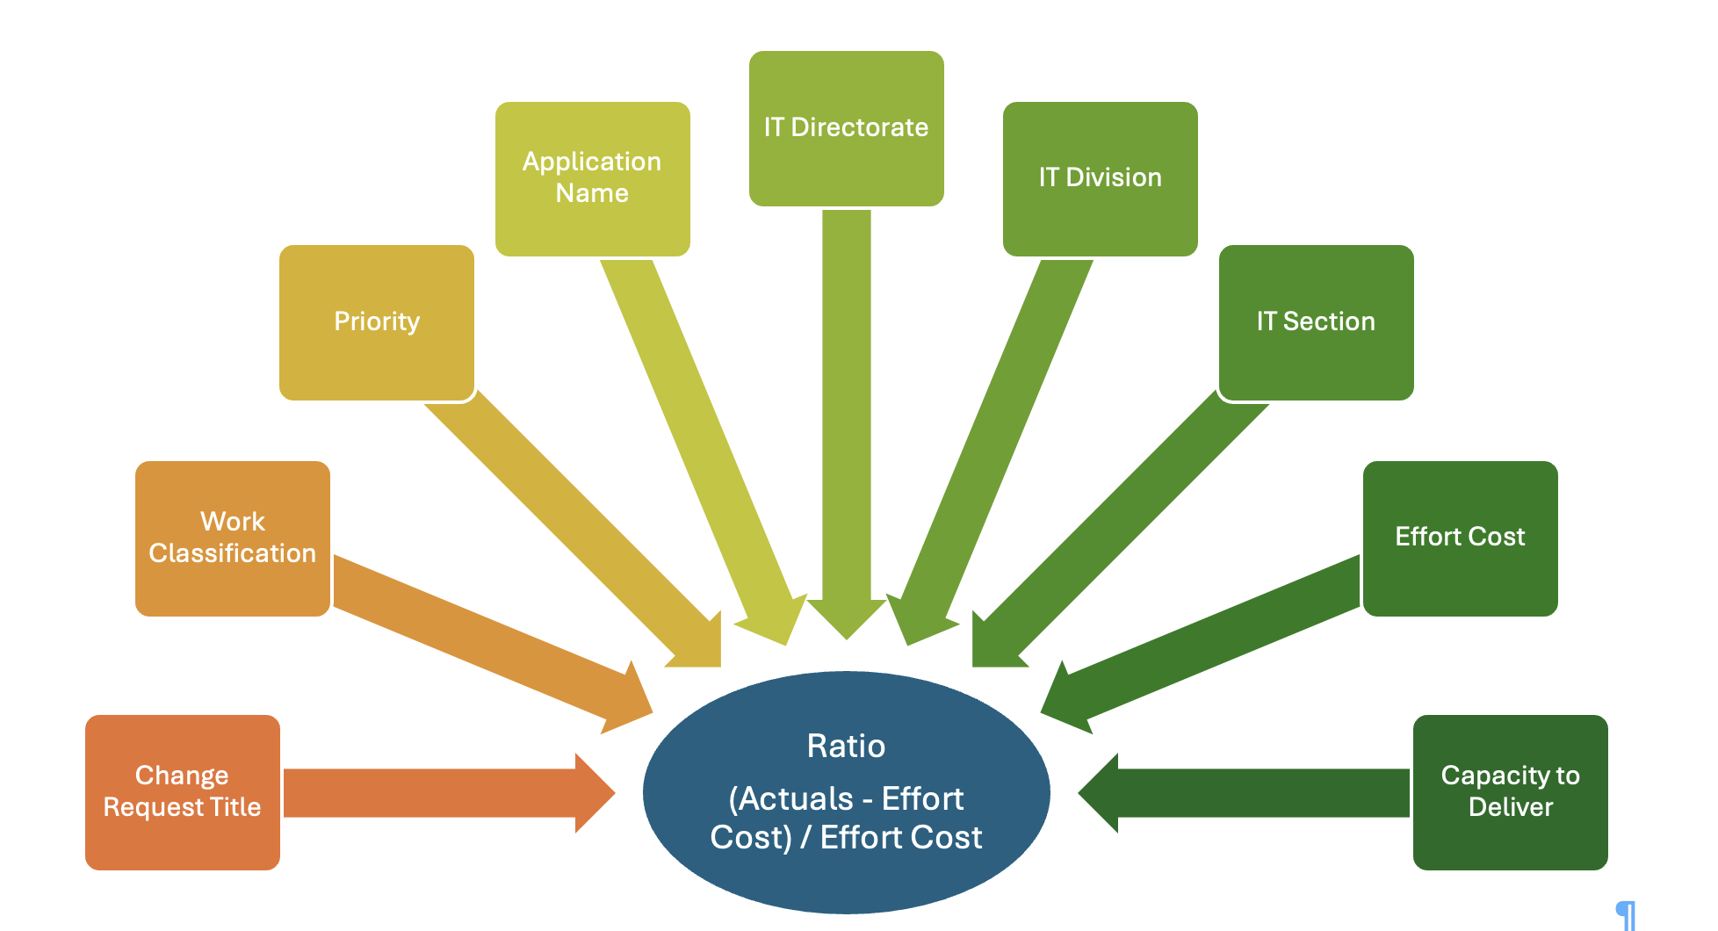
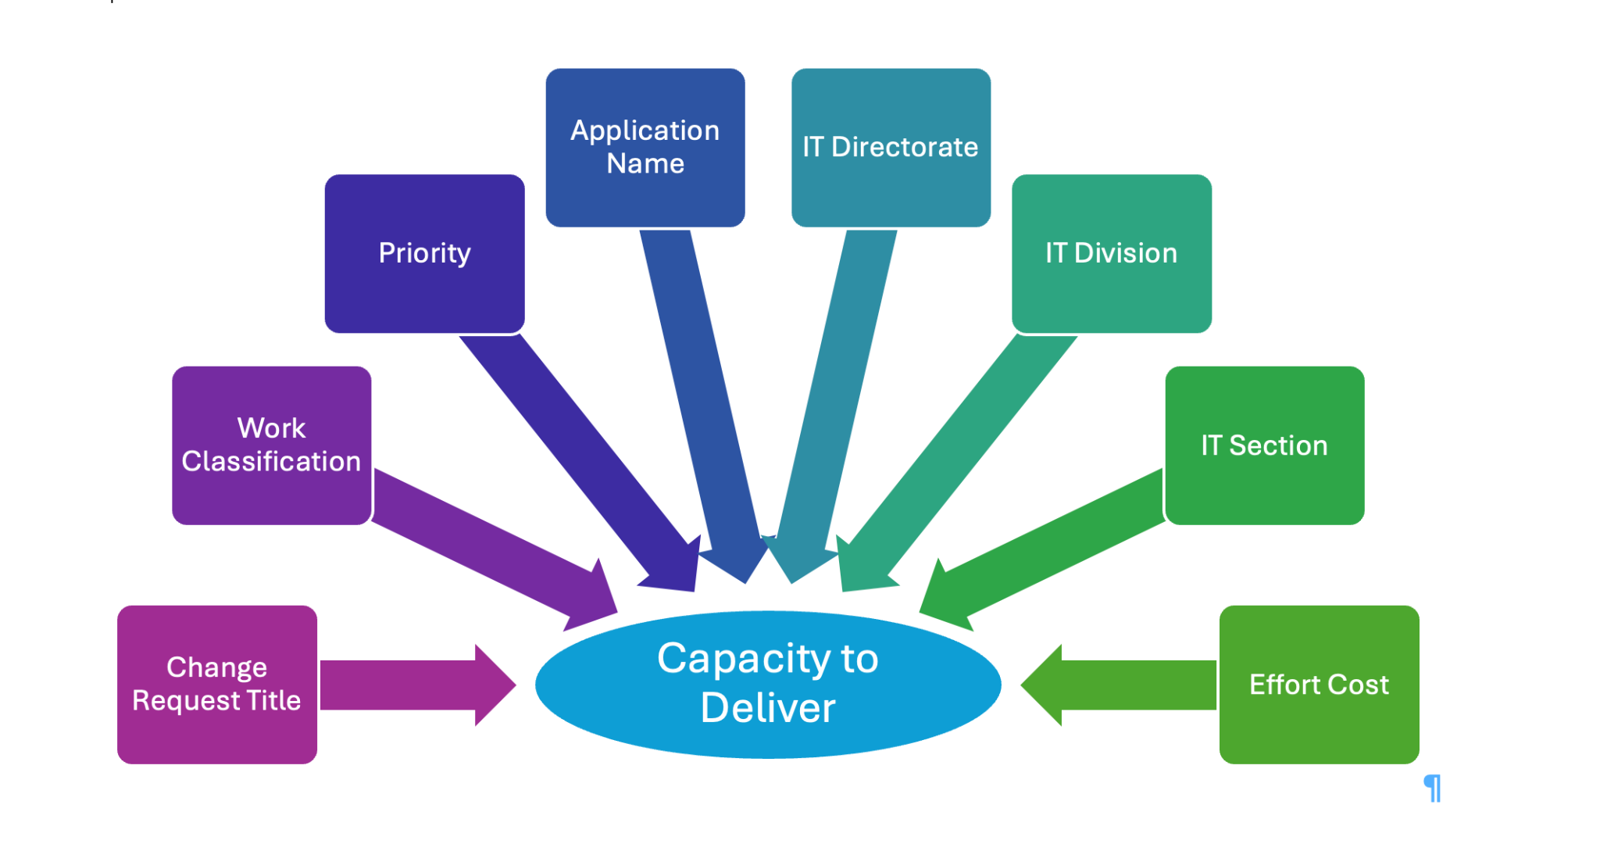
Machine Learning - Input/Output Configuration
（Choose Food Material）
Input/Output Configuration
30%

Slide 10
Machine Learning - Model Tuning Effort（Seasoning）
Model Tuning
80%
Improve performance by finding the best configuration.
Cross validation
Hyperparameter tuning
Encoding
PCA process

Slide 11
Models Evaluation and Comparison (Tasting)
90%
Model Evaluation
Output=Capacity to Deliver (Classification Problem)
 | Logistic Regression | Decision Tree | Random Forest
Accuracy | ✅
Precision | ✅
Recall |  |  | ✅
F1 Score | ✅
Best Model | ✅ | ❌ | ❌

Slide 12
Models Evaluation and Comparison (Tasting)
90%
Model Evaluation
Output=Cost Difference Ratio (Regression Problem)
 | Linear Regression | Decision Tree | Random Forest
MSE |  | ✅
MAE |  | ✅
R2 |  | ✅
Best Model | ❌ |  | ❌
✅
❌
R2<0: This suggests that the model performs worse than simply predicting the mean of the target variable. It indicates that the model is poorly fitted to the data.

Slide 13
Conclusions and Achievements
Conclusion
100%
Conclusions
Project Achinevements and Benefits
We can predict the Capacity of Deliver by using our Logistic Regression Predict Model.
A CRA IT Project Mangement Dashboard
We can not get a good prediction of the Cost Difference Ratio.
A Logistic Regression Predict Model

Slide 14
Run the Demo

Slide 15
Challenges and Solutions
Challenge 1
Frequently encountering the uncertainties about the data.
Solution
Proactive communication with the client to ensure a comprehensive understanding.
Challenge 2
Facing a complex Capstone project and 5 teammates’ different time tables, requiring everyone to be fully involved.
Solution
Team meeting three times a week and using Jira to manage and track the project.

Slide 16
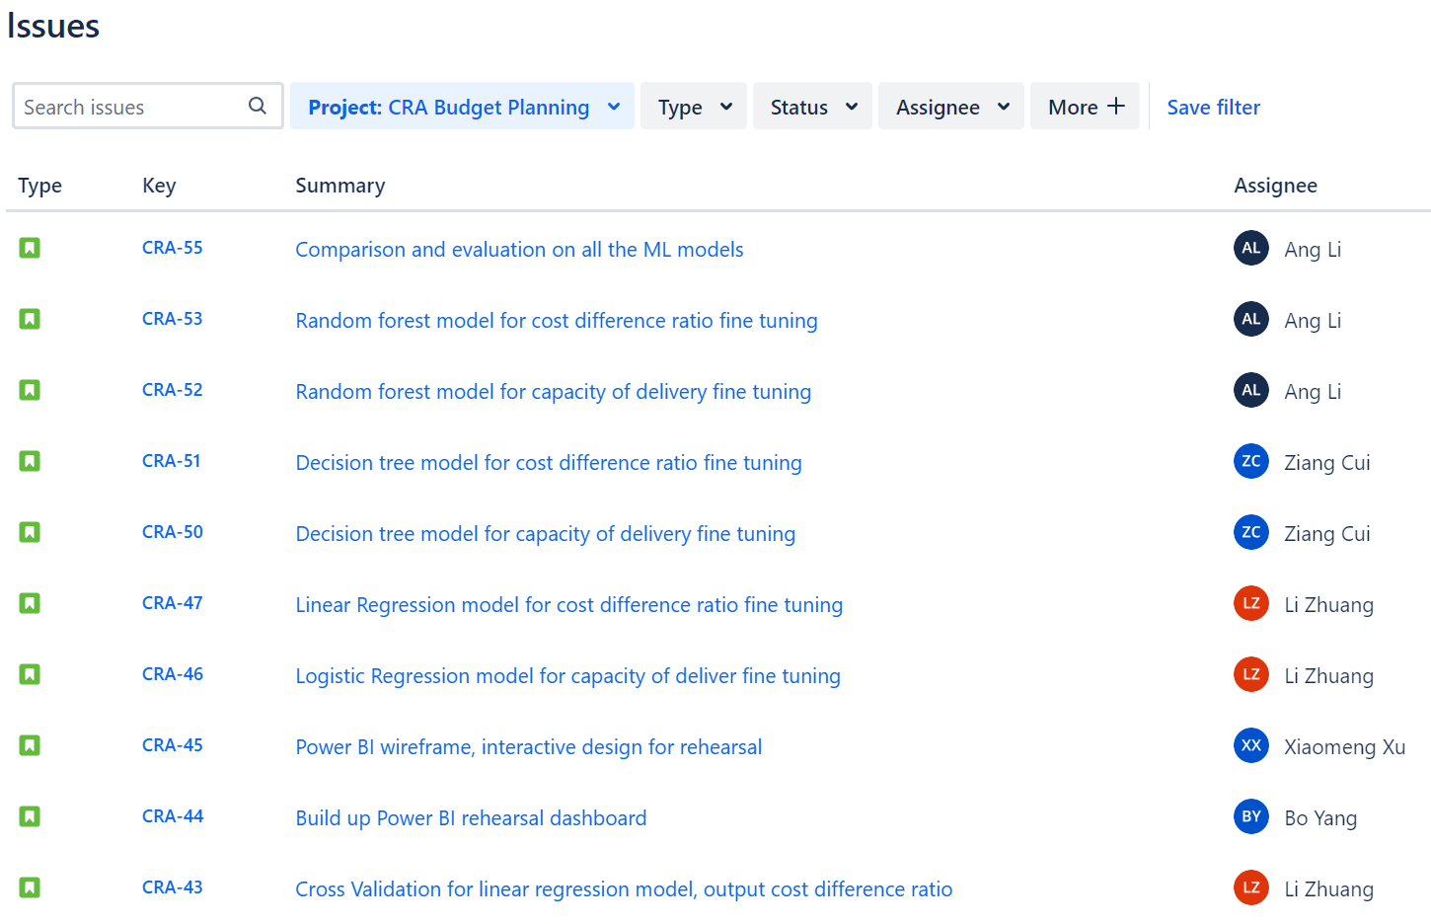
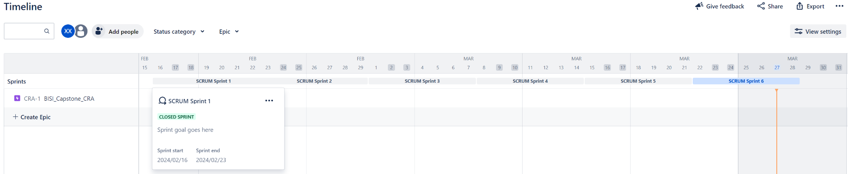
Summary and Future Outlook
Start date:2024/02/8
7 weeks
6 Sprint
55 Issues (including user story, research, etc.)
Delivery: a report slide, a notebook, and a .pbix file
Future Outlook: Prediction for Cost Difference Ratio with large dataset

Slide 17
Team Roles and Responsibilities
Name
Role
Responsibilities
Jira Issues
Prof. Jim
Project owner
N/A
N/A
Ang Li
Team Leader
Scrum master
Machine Learning
12
Li Zhuang
Team member
Machine Learning
12
Ziang Cui
Team member
Scrum master
Machine Learning
9
Bo Yang
Team member
Power BI
7
Xiaomeng
Team member
Power BI
6

Slide 18
Thank You!
Our Clients from Canada Revenue Agency:
David Bedard, Justin Gu, Beatrice Johnston, Yucong Miao, Steve Zheng
Our Professor: Jim Myronyk
Thank you all for Joining this presentation!
Any questions, please feel free to ask.

